Slide 1
Lecture 02: Number System

Slide 2
Objectives
Explain the number system used in computers
- Learn about the digit symbols, base, and representation forms of various number systems developed and used - Explain the method of number system conversions - Explain binary codes and their classifcation

Slide 3
Contents
1. Introduction to Number Systems
2. Base of a Number System
3. Weighting Factor
4. Types of Number Systems
5. Number System Conversions
6. Binary Codes
7. Summary
8. Frequently asked questions
9. Exercises

Slide 4
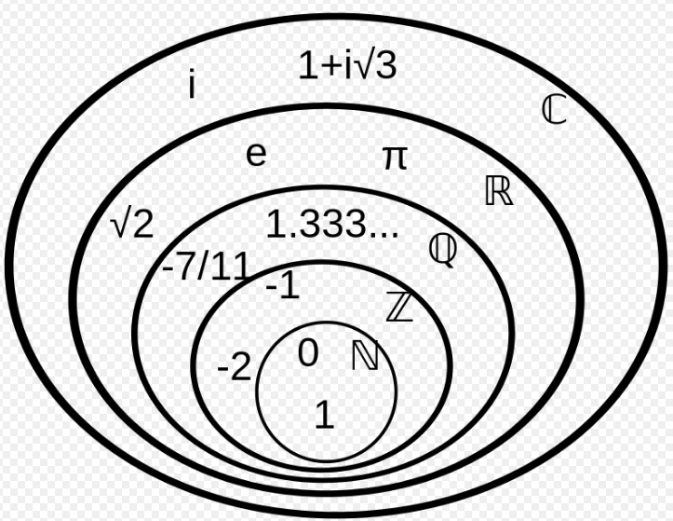
1. Introduction to Number Systems
Long ago, humans used sticks to count; they then learned how to draw pictures of sticks on the ground and eventually on paper. So, the number 5 was frst represented as: | | | | | (for fve sticks)
One of the best ways to represent a number today is by using the modern decimal system. Why?
Subset of the complex numbers

Slide 5
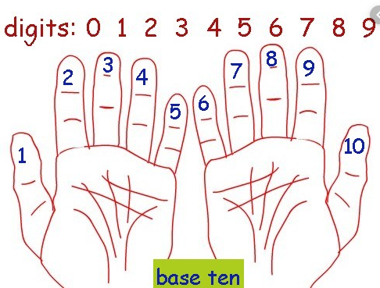
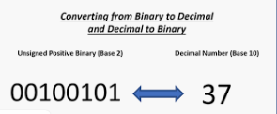
2. Base of a Number System
The base, or radix, of any number system is determined by the number of digit symbols in the system.
For example, binary is a base-2 number system since it uses two symbols and decimal is a base-10 system since it uses ten symbols.

Slide 6
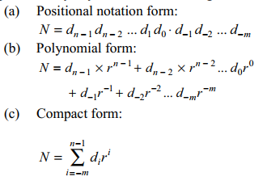
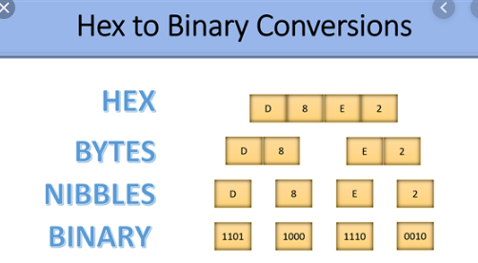
2. Base of a Number System
One example of Hex to binary
Where : d = value of the digit symbol, r = base or radix, n = the number of integral digits to the left of the decimal point, and m = the number of fractional digits or digits to the right of the decimal point

Slide 7
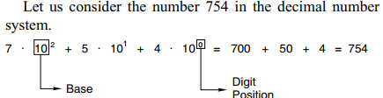
3. Weighting Factor
The numerical value of a number is the sum of the products obtained by multiplying each digit by the weight of its respective position.
The position of each digit in a sequence has a certain numerical weight, and each digit is a multiplier of the weight of its position. The decimal number system is hence an example of a weighted, positional number system. The weight of each position is a power of the base number 10

Slide 8
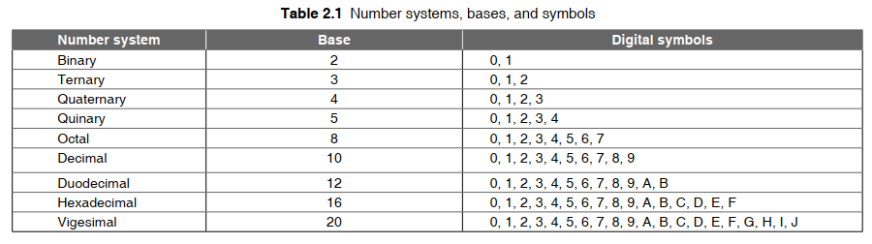
4. Types of Number Systems

Slide 9
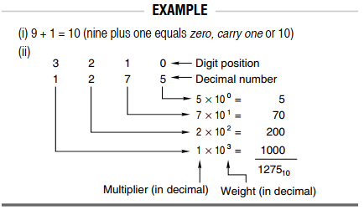
4.1 Decimal number system [Base-10]
Most people today use decimal representation to count. This number system uses TEN different symbols to represent values. In the decimal system there are 10 digit symbols 0, 1, 2, 3, 4, 5, 6, 7, 8, and 9

Slide 10
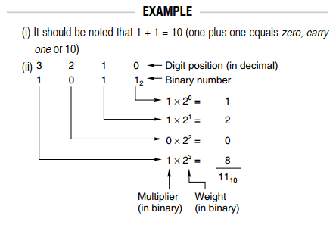
4.2. Binary number system [Base-2]
The binary number system uses TWO symbols to represent numerical values. These are 0 and 1 with 0 having the least value and 1 having the greatest value

Slide 11
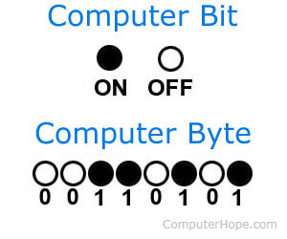
4.2. Binary number system [Base-2]
In a computer, a binary digit representing a binary value (0 or 1) is called a BIT. That is, each digit in a binary number is called a bit, 4 bits form a NIBBLE, 8 bits form a BYTE, two bytes form a WORD and two words form a DOUBLE WORD (rarely used). An n-bit number can represent 2^{n} different number values, for example, for an 8-bit number, 2⁸ = 256 different values may be represented

Slide 12
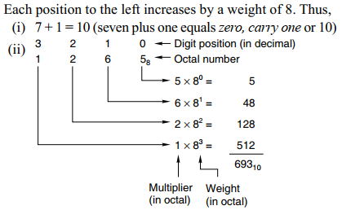
4.3. Octal number system [Base-8]
The octal number system uses EIGHT digit symbols to represent numbers. The symbols are 0, 1, 2, 3, 4, 5, 6, and 7 with 0 having the least value and 7 having the greatest value.

Slide 13
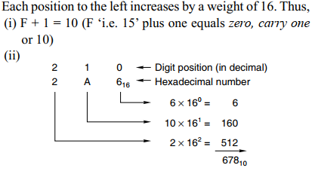
4.4 Hexadecimal number system [Base-16]
The hexadecimal number system uses SIXTEEN symbols to represent numbers. The symbols are 0, 1, 2, 3, 4, 5, 6, 7, 8, 9, A, B, C, D, E, and F with 0 having the least value and F having the greatest value

Slide 14
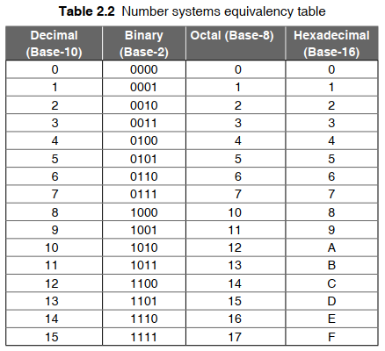
4.4 Hexadecimal number system [Base-16]

Slide 15
4.5 Common rules of number systems
All number systems follow the following set of rules: Rule 1 The number of digit symbols available in a number system is equal to the base. Examples: For the decimal system having base 10, there are 10 digit symbols 0 through 9. For the binary system having base 2, there are 2 digit symbols 0 and 1
Rule 2 The value of the largest digit symbol is one less than the base. Examples: Decimal system—largest digit = 10 – 1 = 9 Binary system—largest digit = 2 – 1 = 1

Slide 16
4.5 Common rules of number systems
Rule 3 Each position multiplies the value of the digit symbol by the base raised to the power of the value equal to the digit symbol position. Examples: Decimal system—consider the number 125 = 1 × 10² + 2 × 10¹ + 5 × 10⁰ Rule 4 A carry from one position to the next increases its weight base times. Examples: Decimal system—consider the number 5—5 = 5 × 10⁰ or 5 ones. Moving the number, one place, to the left, it becomes— 5 × 10¹ or 5 tens or 50. Binary system—consider the number 1—1 = 1 × 2⁰ or 1 one
Moving the number, one place, to the left, it becomes— 1 × 2¹ or two 1’s or 10

Slide 17
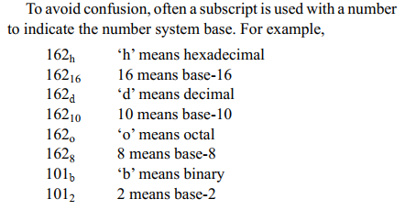
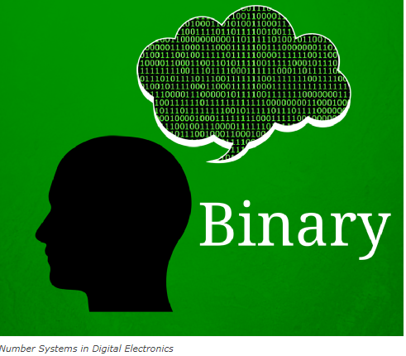
4.5 Common rules of number systems

Slide 18
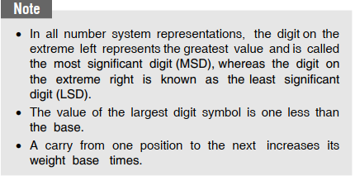
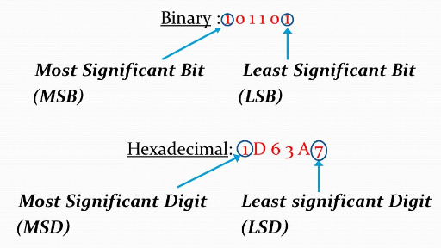
4.5 Common rules of number systems
Example

Slide 19
5. Number System Conversions
Conversion of a decimal number to its binary equivalent
Method 1 (Method 2 in page 33 chapter 2 of reference book)
Repeated division by 2 method 1. Divide the dividend, that is, the decimal number by two and obtain the quotient and remainder. 2. Divide the quotient by two and obtain the new quotient and remainder. 3. Repeat step 2 until the quotient is equal to zero (0). 4. The frst remainder produced is the least signifcant bit (LSB) in the binary number and the last remainder is the most signifcant bit (MSB). Accordingly, the binary number is then written (from left to right) with the MSB occurring first (list the remainder values in reverse order). This is the binary equivalent.

Slide 20
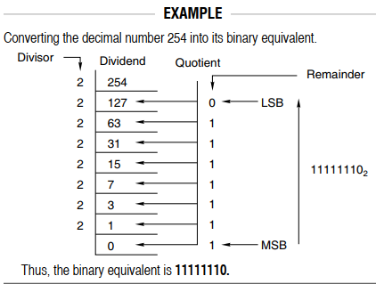
5. Number System Conversions

Slide 21
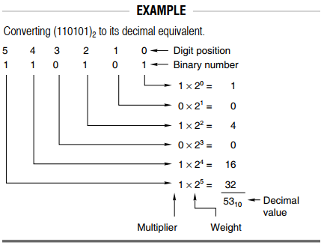
5. Number System Conversions
Conversion from binary to decimal
To express the value of a given binary number as its decimal equivalent, sum the binary digits after each digit has been multiplied by its associated weight.

Slide 22
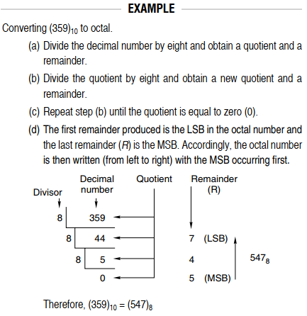
5. Number System Conversions
Conversion of a decimal number to its octal equivalent

Slide 23
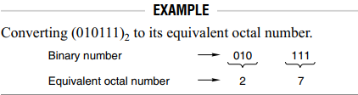
5. Number System Conversions
Conversion of a binary number to its equivalent octal number
Converting a binary number to an octal number is a simple process. Break the binary digits into groups of three starting from the binary point and convert each group into its appropriate octal digit. For whole numbers, it may be necessary to add zeros as the MSB, in order to complete a grouping of three bits. Note that this does not change the value of the binary number

Slide 24
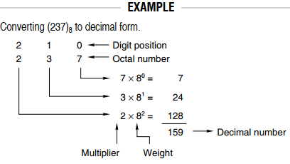
5. Number System Conversions
Conversion of an octal number to its decimal equivalent
To express the value of a given octal number as its decimal equivalent, add the octal digits after each digit has been multiplied by its associated weight

Slide 25
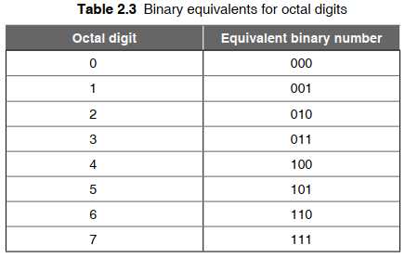
5. Number System Conversions
Conversion of an octal number to its binary equivalent
Since each octal digit can be represented by a three-bit binary number (see Table 2.3), it is very easy to convert from octal to binary. Simply replace each octal digit with the appropriate three-bit binary number as indicated in the following example

Slide 26
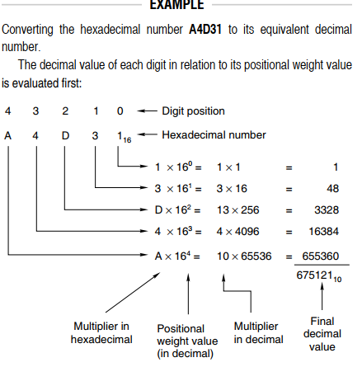
5. Number System Conversions
Conversion of a hexadecimal number to its decimal equivalent To convert a hexadecimal to decimal, begin by multiplying each of the hexadecimal digits by their positional weight values as expressed in decimal. Then the resulting values are added to obtain the value of the decimal number.

Slide 27
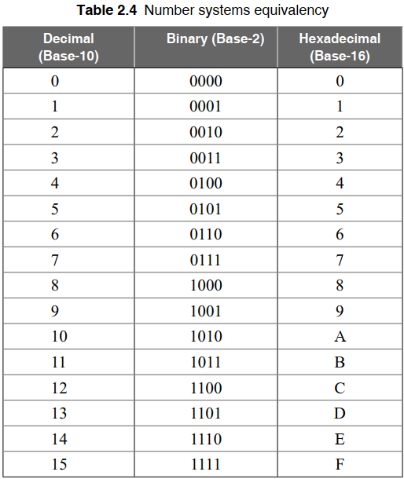
5. Number System Conversions
Conversion of a hexadecimal number to its binary equivalent
As each hexadecimal digit can be represented by a four-bit binary number (see Table 2.4), it is very easy to convert from hexadecimal to binary. Simply replace each hexadecimal digit with the appropriate four-bit binary number as indicated in the following examples.

Slide 28
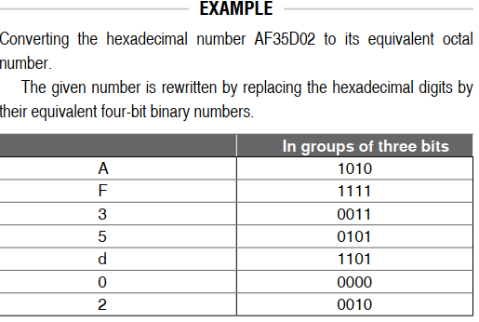
5. Number System Conversions
Conversion from hexadecimal to octal, and octal to hexadecimal
To convert from hexadecimal to octal, each digit of the hexadecimal number is written as its equivalent four-bit binary number. The resulting binary number is divided into groups of three binary digits. Then corresponding octal numbers for each of these groups are written

Slide 29
5. Number System Conversions
However, there are easier conversion methods. Some ways to perform conversion between the bases are as follows.
Any base to decimal Use expanded notation. Write down each digit as a product of a power of the base and add them all.
Decimal to any base Use the division method. Divide the decimal number repeatedly with the base, writing down the remainder at each step. When the quotient becomes zero, the string of remainders is the number in the new base.
Octal to hexadecimal or vice versa Use binary as an intermediate form

Slide 30
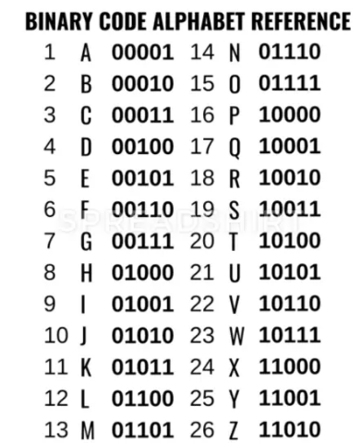
6. Binary Codes
To facilitate extensive communication between humans and digital machines, binary digits 1 and 0 are arranged according to certain defned rules and designated to represent symbols. The method of forming the binary representation is known as encoding and the complete group of binary representations corresponding to the symbols is known as binary code.

Slide 31
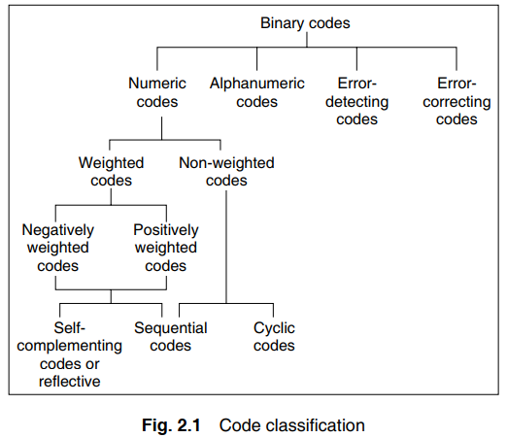
6. Binary Codes

Slide 32
6.1 Alphanumeric codes
Digital computers are capable of handling bits. Keyboards and printers, for example, are devices for transmitting and receiving data to and from computers, respectively. The user inputs data in the form of symbols representing alphabets, numbers, and special characters. These symbols must be represented by some code formed by a sequence of binary digits for the digital computer to process

Slide 33
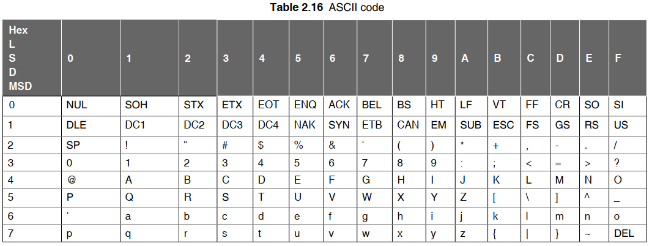
6.1 Alphanumeric codes
The ASCII code, known as the American Standard Code for Information Interchange, is used widely. This is a seven-bit code and hence it can form 27 (128) bit patterns thereby having an ability to encode 128 symbols

Slide 34
6.1 Alphanumeric codes
The standard ASCII code defnes 128 character codes (from 0 to 127), of which the frst 32 are control codes (non-printable) and the other 96 are characters that can be represented. The above table is organized to easily read the ASCII code in hexadecimal form: row numbers represent the lower signifcant digit and the column numbers represent the most signifcant digit. For example, character A is located at row four column one. Thus the ASCII code for character A is represented in hexadecimal as 0x41, which in decimal is65.

Slide 35
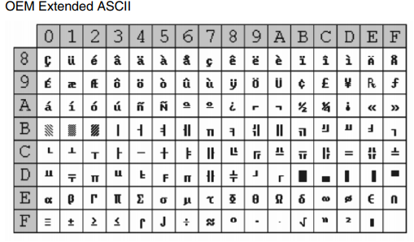
6.1 Alphanumeric codes
The OEM character set is included in the majority of PC compatibles loaded with any operating system or msdos system. It includes diverse symbols, some marked characters and pieces to represent panels. However, it is usually redefned according to regional confgurations to incorporate particular symbols in many countries.

Slide 36
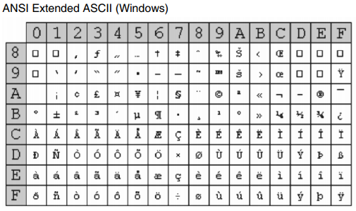
6.1 Alphanumeric codes
The ANSI character set is a standard that is incorporated in systems such as Windows, some unix platforms, and many applications. It includes many local symbols and marked letters so that it can be used without being redefned for other languages.

Slide 37
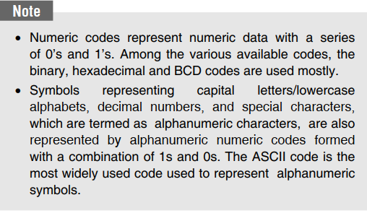
6.1 Alphanumeric codes

Slide 38
7. Summary
The base of a number system has a value equal to the number of representation symbols the system has. A number in a number system, in general, can be represented by any one of the following forms: (a) positional notation form, (b) polynomial form, and (c) compact form. The number systems that are used in computers are binary, octal, and hexadecimal, whereas the decimal system is used by humans. Conversion of binary numbers to decimal numbers, and vice versa, uses the base of the binary number position of the digit. Conversion of binary to octal and vice versa, binary to hexadecimal and vice versa, and all other conversions between different number systems is possible.

Slide 39
8.Frequently asked questions
1. What is a binary number?
answer: A binary number is made of 0s and 1s. In the binary number system only two symbols, 0 and 1, are used to represent numeric values. The symbol “0“ represents the value “zero” while the symbol “1” represents the value “one”. Since there are only two symbols in the binary number system, the value “two” is represented by placing the symbol “1” on the left–hand side of the symbol “0” resulting in the binary equivalent “10”. Next, the value “three” is represented by “11” in the binary number systemby replacing the “ 0 ” in “10” by the next higher value symbol “1”. A sample table depicting the binary equivalent representation for different decimal numbers upto nine is shown below

Slide 40
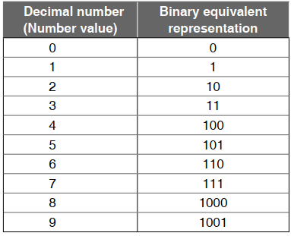
8.Frequently asked questions
Herein, it may be noted that as the number value increases the digit positions on the left-hand side of the binary equivalent number increases. Each increase of the digit position to the left signifes an increase by 2 in the value of the number represented in the binary number system. Since the number of symbols in the binary number system is two, the radix of this number system expressed in decimal is 2.

Slide 41
8.Frequently asked questions
2. What is meant by ‘bit’?
answer: The abbreviated form of “ bi-nary dig-it ” is known as bit. When a “bit” is mentioned, it means a single binary digit, which may either be a “0” or “1”, is referred to.

Slide 42
8.Frequently asked questions
3. Why do digital computers use binary numbers for their operations? answer: A survey of the history of development of computers would reveal that the primary objective of computer designers as to construct a computer that would carry out all types of arithmetical calculations. This was achieved by initially employing mechanical devices and then improving it with the addition of electrical devices. But these computing machines were calculators with no programmable facilities. The need for programmability was also met using the mechanical and electrical devices. Meanwhile analog computers were in use for solving not only arithmetical problems but

Slide 43
8.Frequently asked questions
also mathematical problems which included integro-differential equations, etc. But with the availability of electronic devices and application of Boolean logic concepts digital computers were developed that execute jobs at much high speeds, consume less power, occupy much less space, weigh many times less, work reliably with very less maintenance effort and are easy to operate. As a consequence digital computers, that employed electronic devices and applied Boolean logic concepts, outperformed all earlier models of computers. And because the digital computers use Boolean logic concepts, binary numbers are obviously used in digital computers

Slide 44
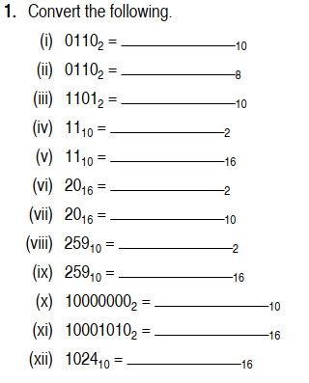
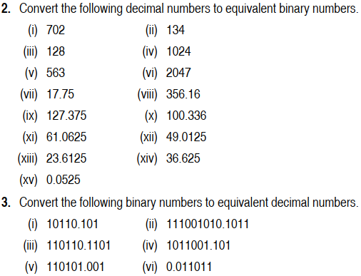
9. Exercises

Slide 45
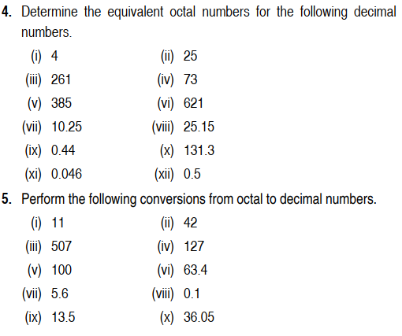
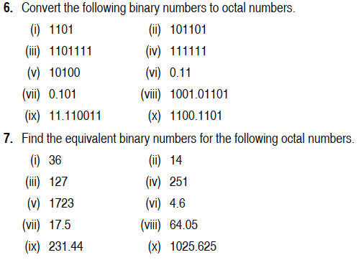
9. Exercises

Slide 46
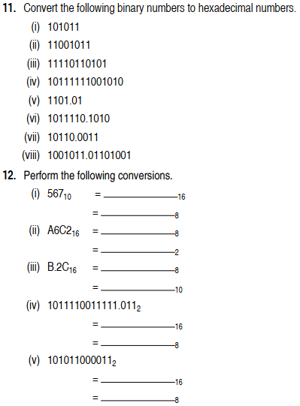
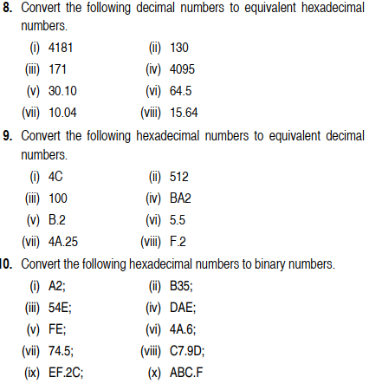
9. Exercises

Slide 47
Reference
Chapter 2, Pradip Dey, Manas Ghosh - Computer Fundamentals and Programming in C-Oxford (2013)

